Slide 1
Predictive analysis
City wise house prediction in India

Slide 2
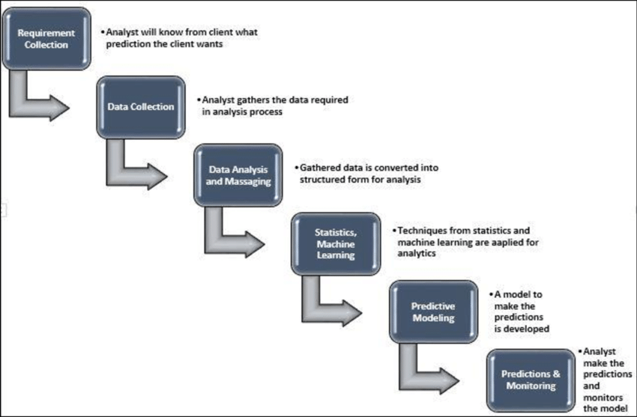
PROCESS OF PREDICTIVE ANALYTICS

Slide 3
BUSINESS REQUIREMENT
Our business requirement is to predict the house prices of various main cities in India
99 acers is a new large India house platform that aims to make it easier for individuals to sell their houses themselves.
This project will be helpful for house seekers and sellers to know a range within which the house value is expected to lie in that particular area or location

Slide 4
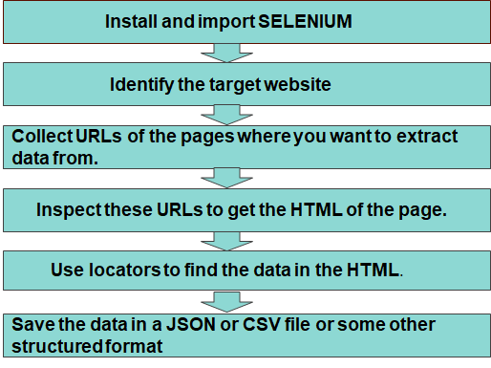
DATA COLLECTION
PROCESS OF DATA COLLECTION USING SELENIUM

Slide 5
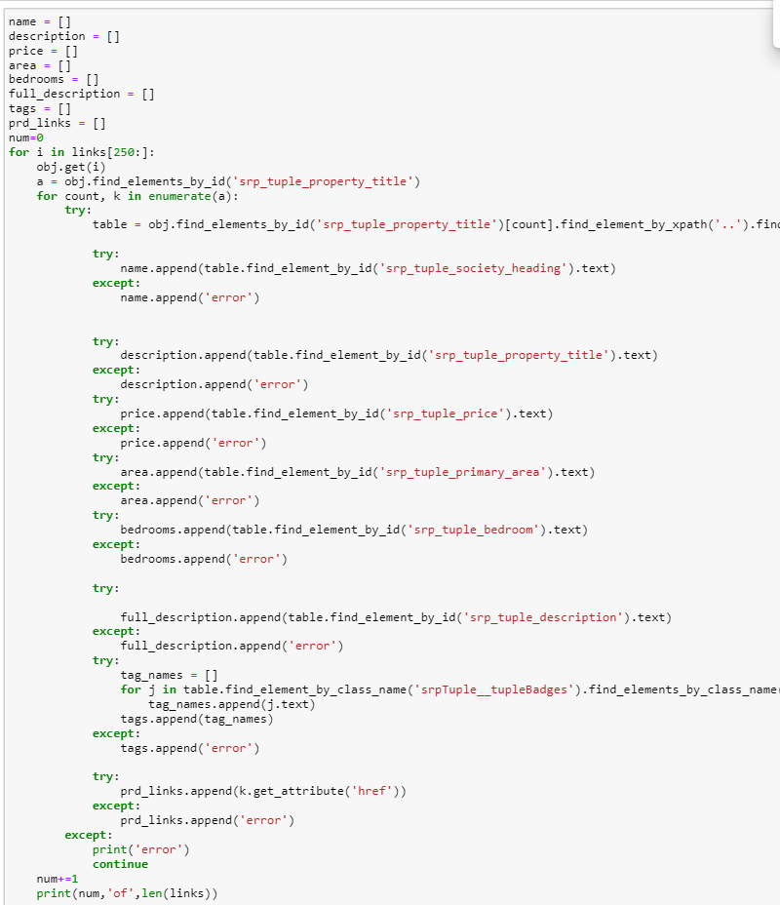

Slide 6
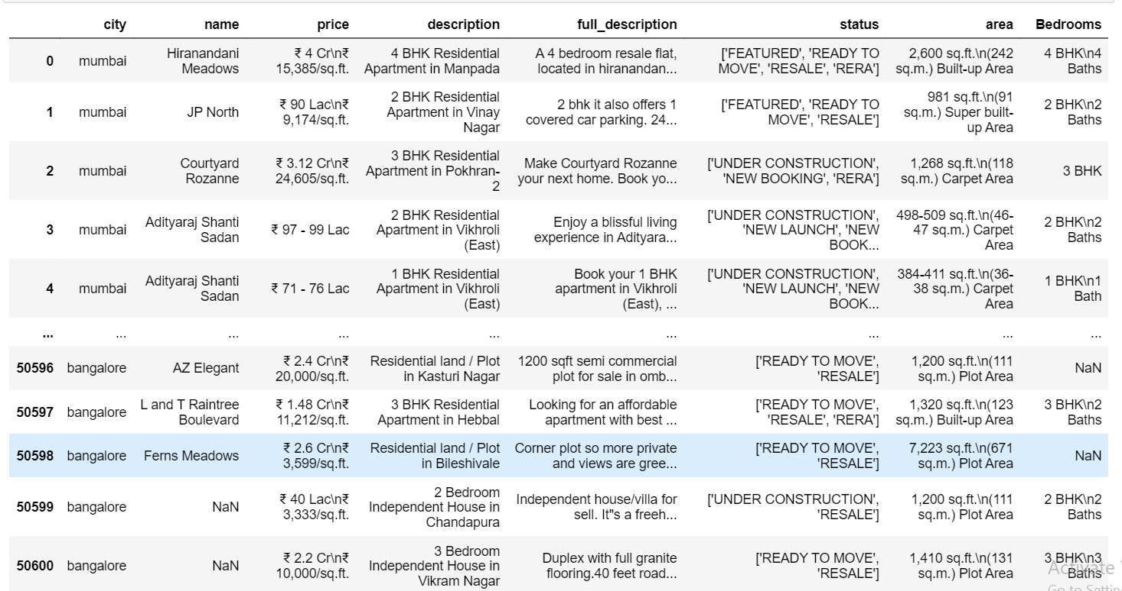
DATA SET OBTAINED FROM SCRAPING

Slide 7
DATA ANALYSIS
Data analysis is a process of inspecting, cleansing, transforming, and modeling data with the goal of discovering useful information, informing conclusions, and supporting decision-making.
DATA ANALYSIS
Data Wrangling
Data Cleansing
Data Mining

Slide 8
DATA WRANGLING
Data wrangling, sometimes referred to as data munging, is the process of transforming and mapping data from one "raw" data form into another format with the intent of making it more appropriate
Process of data wrangling:
Gathering the data
Filtering the data
Converting the data

Slide 9
Some of the techniques used in data wrangling:
Split functions
REGex (Regular expressions)
Converting strings into float
Lambda functions
Examples:
1)def txt_split(text):
sq_txt = text.split('\n')[0].lower()
return sq_txt
2) df_reg = df_reg.replace('^₹'," ",regex=True)

Slide 10
3)avg = []
for i in reg_p:
lst = [float(x) for x in i]
lst_avg = mean(lst)
avg.append(lst_avg)
4)df['status_of_house']=df['status'].apply(lambda x: 'UNDER CONSTRUCTION' if n 'UNDER CONSTRUCTION' in x else 'READY TO MOVE')

Slide 11
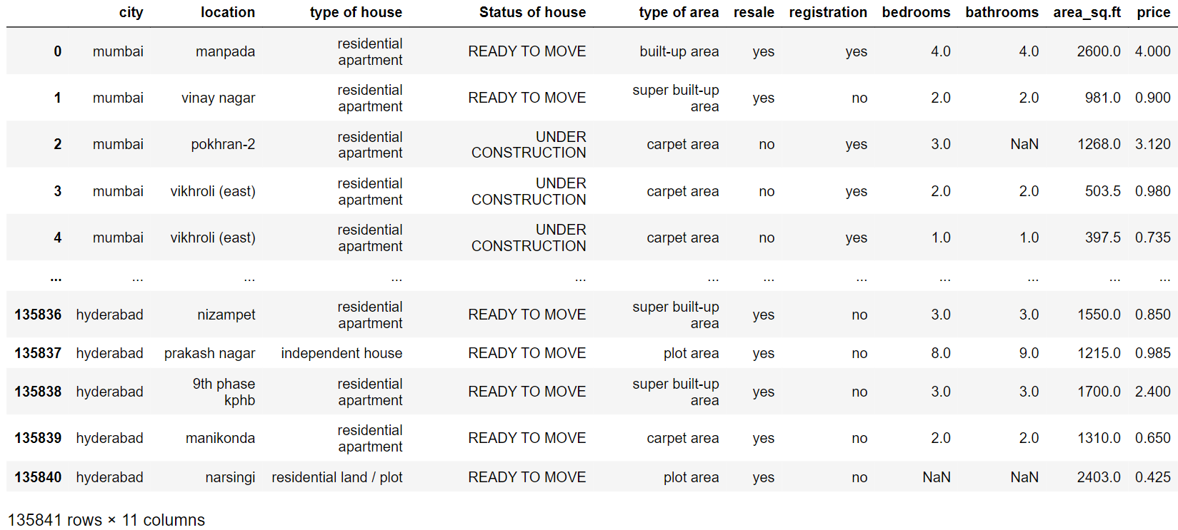
Data set obtained after data wrangling

Slide 12
DATA CLEANSING
Data cleansing or data cleaning is the process of detecting and correcting (or removing) corrupt or inaccurate records from a record set, table, or database
Process of data cleansing:
Import data after data wrangling
Merge the data sets
Rebuild missing values
Standardizing the outliers -- filling Nan(not a number values)
Removing unwanted data
Removing duplicates

Slide 13
Some of the techniques used in data cleansing are:
Filling Nan(Not a number) values with KNN imputation method
Outlier detection in Feature Engineering concepts have been used such as:
1) Inter Quantile Range(IQR)
2) Standard deviation
3) Z-Score
[Note: Inter Quantile range(IQR) has given the best output According to the box plots]

Slide 14

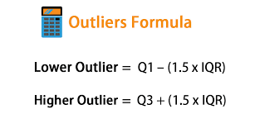
Formula:
KNN imputer:
IQR:

Slide 15
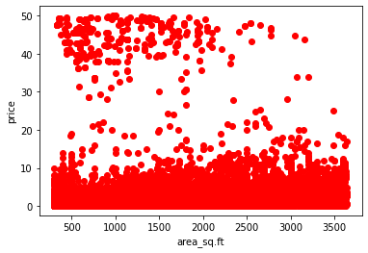
DATA VISUALIZATION
Data Visualization is the graphical representation of information and data. By using visual elements like Charts, Graphs and maps, data visualization tool provide an accessible way to see and understand trends,outliers and patterns in data.
Scatter plot : The graph b/w area of the house and the price is as below

Slide 16
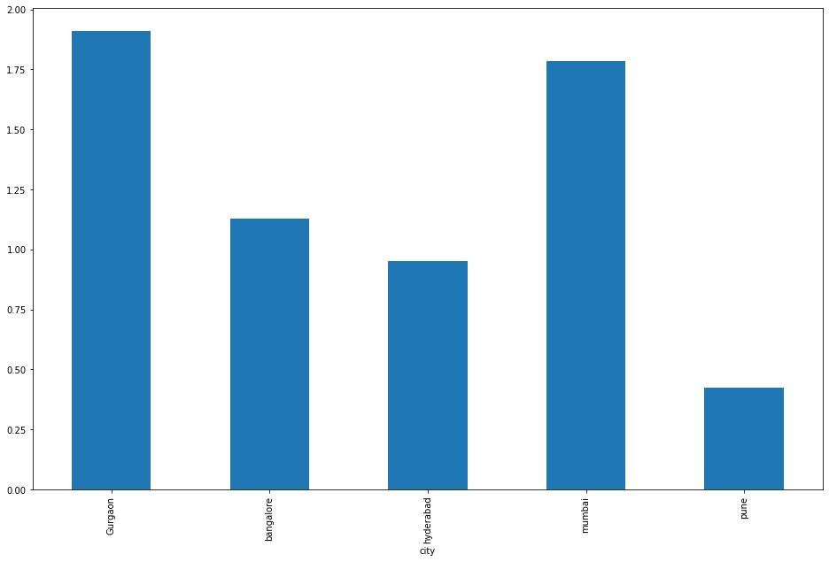
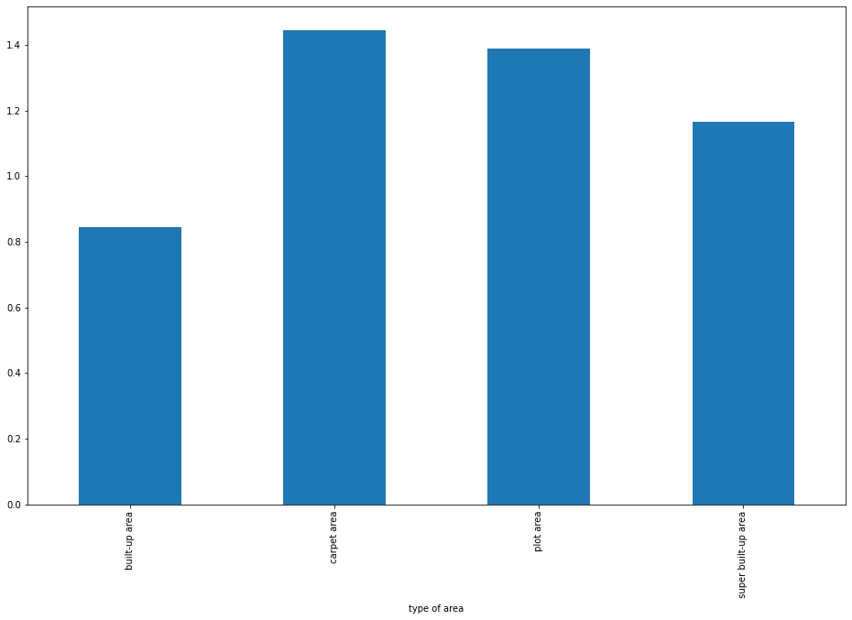
2) Bar charts :
Relationship between city and price:
Relationship between type of area and price:

Slide 17
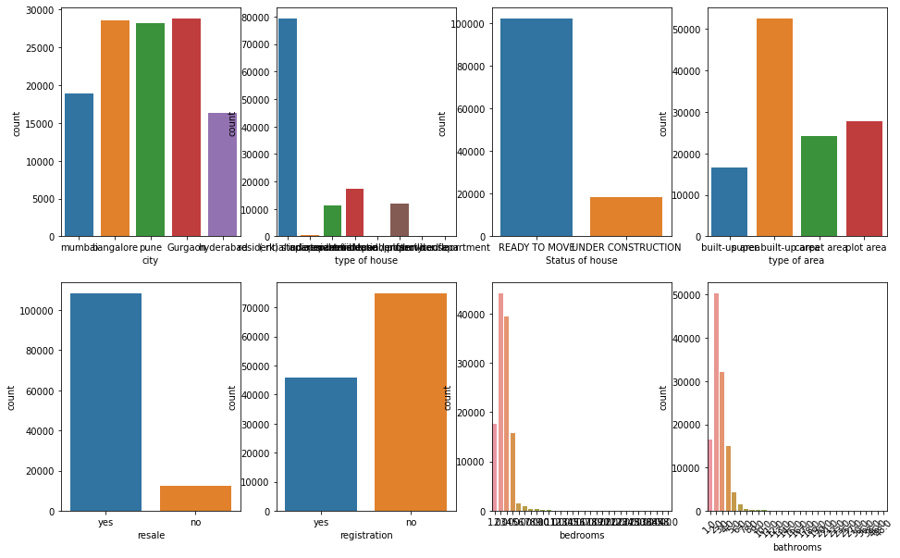
3) Counter plot :

Slide 18
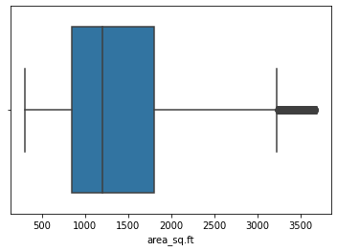
4) Box plot :
Representation of outliers in area of the house

Slide 19
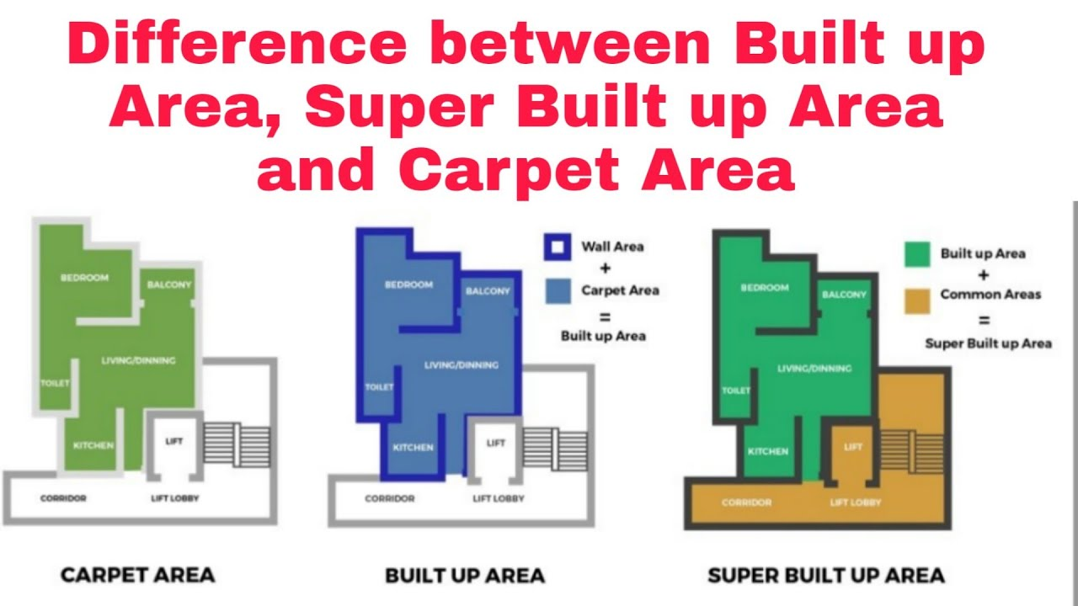
FEATURES OR VARIABLES OF THE DATA SET
INDEPENDENT VARIABLES:
CITY : The City names of the houses
LOCATION : Various locations of the house in the city
PRICE : Price of the houses which are given per sq.ft
STATUS OF THE HOUSE : It gives the update of the construction
TYPE OF AREA : Type of Outline of that area

Slide 20
TYPE OF HOUSE: Different types of houses available of sale
BEDROOMS :Count of no.of bedrooms in the house
BATHROOMS : Count of no.of bathrooms in the house
RESALE : Whether the house is resalable or not
REGISTRATION : To know whether the house have registration papers or not
DEPENDENT VARIABLE:
PRICE : Selling price of the house

Slide 21
FEATURE ENGINEERING
OneHotEncoding and Get dummies have been used to convert the categorical variables into categorical numerical variables.
KNN imputation has been used to fill the Nan values
Splitting the data into dependent and independent values
Splitting the data into testing and training data
Log normal transformation has been used in area_sq.ft and price features to get the accurate results
Scikit-learn, pandas and numpy are the libraries used for the feature engineering

Slide 22
DATA MODELLING
A machine learning model is a file that has been trained to recognize certain types of patterns
Packages used for modelling are scikit_learn,Catboost
We use different types of algorithms based on the type of problem statements. Some of the algorithms used in this data are:
1) Linear Regression
2) Decision Tree Regression
3) SVM (Support Vector Machine) -- SVR(Support Vector Regressor)
4) Random Forest Regression
5) Adaboost regression.
6) Gradient boosting regression.
7) XGBoost regression.
8) CatBoost regression

Slide 23
ACCURACIES
ALGORITHMS | R2 SCORE - TEST | R2 SCORE - TRAIN
Linear Regression | 0.35 | 0.37
Decision Tree Regressor | 0.66 | 0.71
Random Forest Regressor | 0.68 | 0.72
SVR | 0.54 | 0.54
XGBoost Regressor | 0.62 | 0.63
Gradient Boosting Regressor | 0.68 | 0.76
CatBoost | 0.70 | 0.73
Ada Boosting Regressor | 0.33 | 0.35

Slide 24
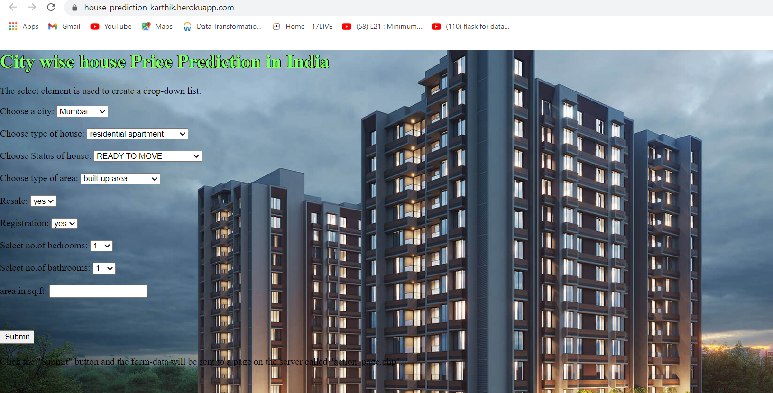
DEPLOYMENT
Deployment is the method by which you integrate a machine learning model into an existing production environment to make practical business decisions based on data
Cat Boost Regressor gave the best possible accuracy compared to other algorithms
For deployment, we write a flask application and create web application in local host.
Created a web application in Heroku ‘https://house-prediction-karthik.herokuapp.com/’

Slide 25
THANK YOU

